Slide 1
Fundamentals of EMC
Grounding
John McCloskey
NASA/GSFC Chief EMC Engineer
Code 565
Building 23, room E203
301-286-5498
John.C.McCloskey@nasa.gov

Slide 2
Topics
Introduction
Reasons for “Grounding”
“Grounding” in the “Real World” (and in “Real Space”)
Bonding

Slide 3
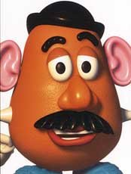

The Ground Mystery
    “The search for a ‘good ground’ is very similar to the search for the Holy Grail in many respects – tales abound about its existence and we all say we want and need it, but we cannot seem to find it.”
      - Warren H. Lewis
    “Ground is a place where potatoes and carrots thrive.”
      - Dr. Bruce Archambeault

Slide 4
The Ground Mystery (cont.)
“Classic” definition
  An equipotential point, plane, or surface that serves as the reference potential for a circuit or system
  Impossible to achieve in practice
More useful definition
  Low impedance path for currents to return to their respective sources
  Kirchoff’s current law:
    All currents return to their sources following path of least IMPEDANCE
    NOT always path of least resistance
Currents do NOT return to “ground”
  They may use ground as the return path to their source, if that is the path of least impedance

Slide 5
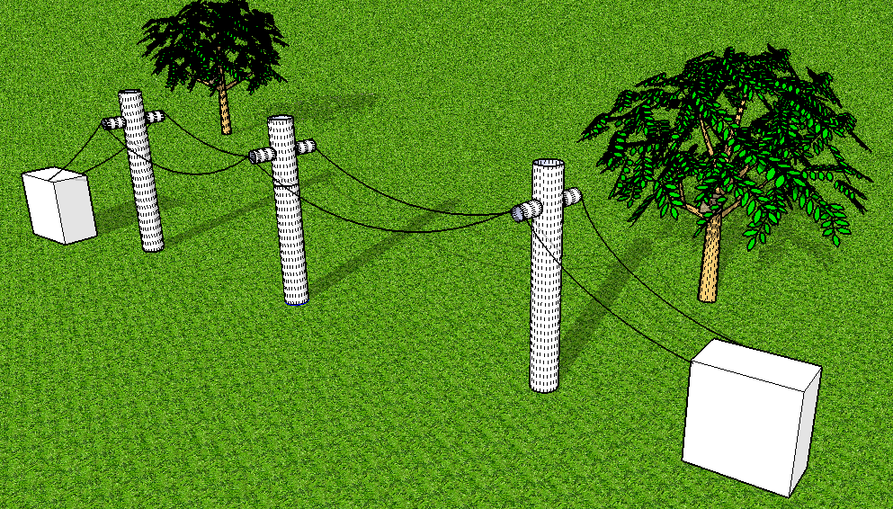
Origin of the Term “GROUND”
Ground/Earth
Teletype
Receiver
Teletype
Transmitter
EARTH USED AS CURRENT RETURN PATH
Courtesy of Dr. Bruce Archambeault

Slide 6
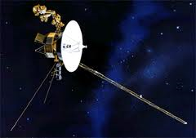
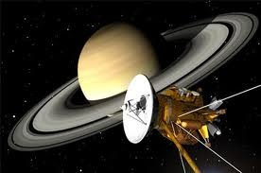
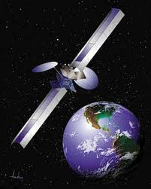

“Ground” in Space?

Slide 7
References
Documents available on GSFC EMC Working Group XSPACES page (https://xspaces.gsfc.nasa.gov/display/EMCWG/Home):
  NASA-HDBK-4001, Electrical Grounding Architecture for Unmanned Spacecraft
  NASA-HDBK-4002A, Mitigating In-Space Charging Effects - a Guideline
  NASA-STD-4003, Electrical Bonding For NASA Launch Vehicles, Spacecraft, Payloads, and Flight Equipment
  NASA-HDBK-419A, Volumes 1 & 2, Grounding, Bonding, and Shielding for Electronic Equipments And Facilities
  IEEE STD 1100™-2005, IEEE Recommended Practice for Powering and Grounding Electronic Equipment (“Emerald Book”)
  NASA-HDBK-8739.21, Workmanship Manual for Electrostatic Discharge Control
  Marshall Space Flight Center Electromagnetic Compatibility Design and Interference Control (MEDIC) Handbook
  MIL-STD-461F, Requirements for the Control of Electromagnetic Interference Characteristics of Subsystems and Equipment

Slide 8
Topics
Introduction
Reasons for “Grounding”
  Safety
  Lightning protection
  Electrostatic Discharge (ESD) mitigation
  Common reference potential
  Current return path
“Grounding” in the “Real World” (and in “Real Space”)
Bonding

Slide 9
Safety Ground – Facility Power (Green Wire)
Provides low impedance path for fault currents back to source
Must have sufficient current capacity to ensure that breaker clears
Prevents high potential from developing on chassis (shock hazard)
SERVICE ENTRANCE PANEL
BREAKER TRIPS
(GOOD)
CHASSIS
120 V @ 60 Hz (HOT)
FAULT
NEUTRAL
LOAD
GROUND (SAFETY)
FAULT CURRENT PATH
(raison d’être of Green Wire)
GROUND ROD
EARTH

Slide 10
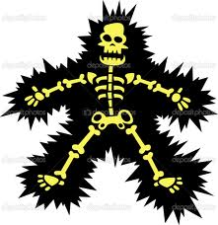
Safety Ground – Facility Power (cont.)
WITHOUT GREEN WIRE:
YOU
ARE THE FAULT CURRENT RETURN PATH
(BAD)
SERVICE ENTRANCE PANEL
BREAKER MAY NOT TRIP
(BAD)
CHASSIS
120 V @ 60 Hz (HOT)
FAULT
NEUTRAL
LOAD
NO GREEN WIRE
GROUND ROD
EARTH

Slide 11

Safety Ground – Spacecraft Power (Structure)
On spacecraft, structure provides return path
  Performs same function as green wire
FUSE CLEARS (GOOD)
short to chassis
V_{S}
R_{L}
FAULT CURRENT RETURN PATH

Slide 12
Safety Ground – Spacecraft Power (Structure)
+28 Vdc may not be a significant shock hazard, but…
  A poor (high impedance) connection in the fault current return path will limit the fault current
  Hardware can be damaged without blowing fuse (bad)
FUSE MAY NOT CLEAR (BAD)
V_{S}
R_{L}
HIGH IMPEDANCE CONNECTION
FAULT CURRENT RETURN PATH

Slide 13
Safety Ground Summary
Safety ground connection MUST be present and verified in ALL configurations:
  I&T
  Flight
  Bench level
  Etc.
NON-NEGOTIABLE!!!

Slide 14
Lightning Protection
Lightning rod diverts discharge current to earth
Keeps discharge current away from:
  Circuits in building
  Flammable building parts
Primary reason for connection to earth
LIGHTNING ROD
I
EARTH

Slide 15
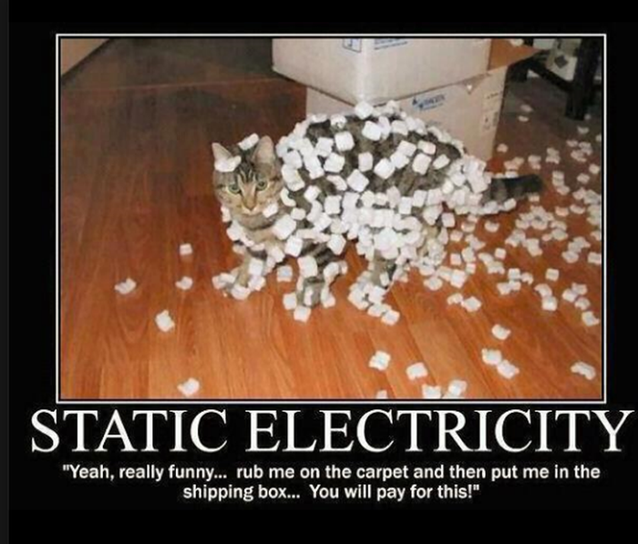
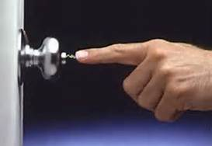
Electrostatic Discharge (ESD) Mitigation
ΔV
I

Slide 16
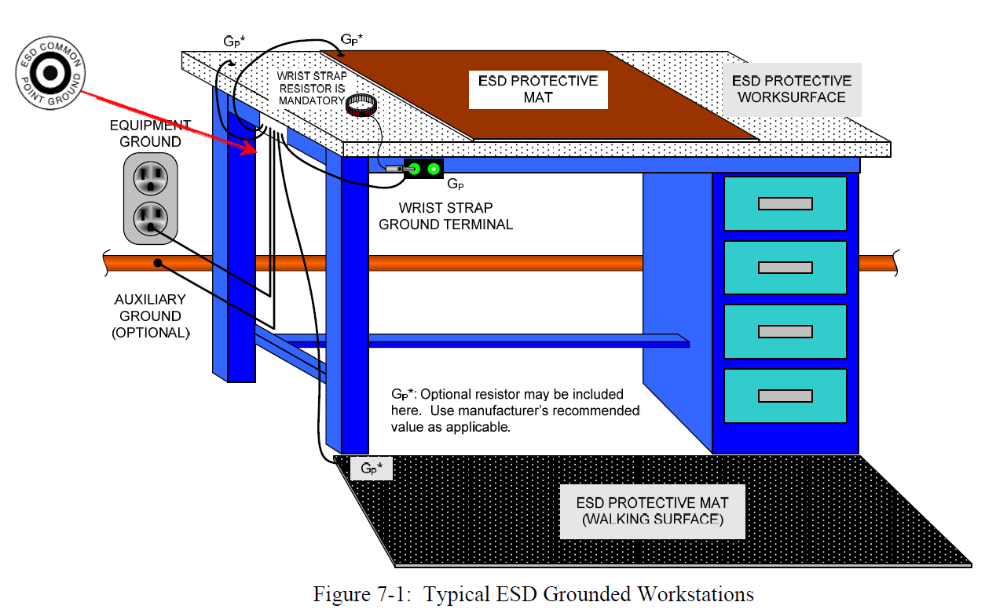
ESD Mitigation (cont.)
NASA-HDBK-8739.21, Workmanship Manual for Electrostatic Discharge Control

Slide 17
Common Reference Potential
Interface signals between 2 circuits need common reference potential in order to work properly
Traditionally called:
  Ground
  Earth
  Zero volt reference
  Common
SIGNAL 1
SIGNAL 2
CIRCUIT 1
SIGNAL 3
CIRCUIT 2
SIGNAL 4
SIGNAL 5
SIGNAL 6
“GROUND”
“EARTH”
“0 V”
“COMMON”

Slide 18
Current Return Path
Signal and power currents must return to their respective sources (Kirchoff’s Current Law)
Traditionally, “ground” is default return path
Aircraft and automobiles use structure as return path for power feeds
  Fewer wires
  Less mass, less $$$, etc.
SIGNAL 1
SIGNAL 2
CIRCUIT 1
SIGNAL 3
CIRCUIT 2
SIGNAL 4
SIGNAL 5
SIGNAL 6
I

Slide 19
Topics
Introduction
Reasons for “Grounding”
“Grounding” in the “Real World” (and in “Real Space”)
  NASA-HDBK-4001
  Single-Point vs. Multi-Point
  Ground Bounce
  Current return
  Ground Plane
Bonding

Slide 20
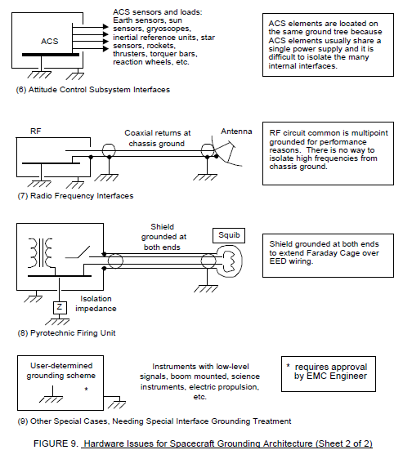
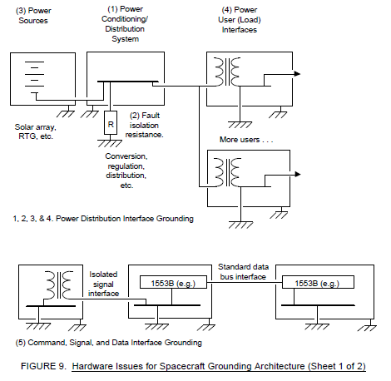
NASA-HDBK-4001
Guidelines provided in NASA-HDBK-4001, Electrical Grounding Architecture for Unmanned Spacecraft

Slide 21
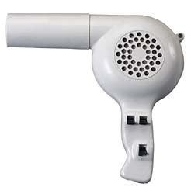
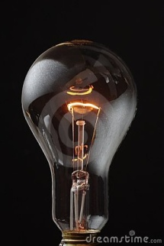
Single Point Ground
“Daisy Chained” connections (not recommended)
Very susceptible to common impedance coupling
CIRCUIT 1
CIRCUIT 2
CIRCUIT 3
V_{N1}
V_{N2}
GROUND CURRENT FROM CIRCUIT 3 PRODUCES NOISE VOLTAGE ON CIRCUITS 1 & 2

Slide 22

Single Point Ground (cont.)
Single point “star” ground (better)
Ground currents separate
Less susceptible to common impedance coupling
CIRCUIT 1
CIRCUIT 2
CIRCUIT 3
SEPARATE CURRENT PATHS

Slide 23
Single Point Ground (cont.)
Single point excellent for truly isolated circuits (no interconnections)
Interconnections complicate the situation
Introduce possibility of:
  Current loops
  Magnetic coupling
CIRCUIT 1
CIRCUIT 2
CIRCUIT 3
I
I

Slide 24
Single Point Ground (cont.)
“Isolation” allows potential difference to form between conductors
  Allows common mode current to flow across stray capacitance
  Causes radiated fields
“Single point ground” is ineffective and impractical at high frequencies!!!
CIRCUIT 1
CIRCUIT 2
CIRCUIT 3
ΔV
I_{CM}
I_{CM}

Slide 25
Multi-Point Ground
“Multi-point” ground is most effective at high frequencies
  Connect to common ground plane or structure
  Reduces potential difference between conductors
  Reduces common mode currents
  Reduces radiated fields and improves susceptibility
CIRCUIT 1
CIRCUIT 2
CIRCUIT 3
ΔV → 0
I_{CM} → 0
ROUTE INTERCONNECTIONS AS CLOSE AS POSSIBLE TO GROUND PLANE
(MINIMIZES LOOP AREA)

Slide 26
Ground Bounce
Non-ideal “ground”
  There is always a non-zero impedance between circuit grounds
  Currents on interface signals can induce a potential between circuit grounds seen by all other interface signals
    Called “common mode noise” or “ground bounce”
    Common mode currents can induce noise on interface signals (next slides)
SIGNAL 1
SIGNAL 2
CIRCUIT 1
SIGNAL 3
CIRCUIT 2
SIGNAL 4
SIGNAL 5
SIGNAL 6
Z_{g}
V_{CM}
I_{CM}
-
+
SIGNAL 1 RETURN CURRENT CAUSES COMMON MODE VOLTAGE ON GROUND REFERENCE SEEN BY ALL OTHER SIGNALS

Slide 27
Ground Bounce (cont.)
Ground bounce – a DC perspective
  Produces common mode (error) voltage V_{CM} in receiver circuit
  Minimize V_{CM} by:
    Minimizing common mode current I_{CM} and/or
    Minimizing ground impedance Z_{g}
V_{I} = V_{O} - V_{CM}
V_{O}
Z_{g}
I_{CM}
V_{CM} = I_{CM} Z_{g}

Slide 28
Ground Bounce (cont.)
Ground bounce – an AC perspective
  Can cause noise on digital signals as well as analog
  Noise on digital signals can cause false transitions
  Such noise on a clock line can lock up a state machine
  Digital circuits are not immune!!!
POSSIBLE FALSE TRANSITIONS
V_{I}
V_{O}
GROUND BOUNCE CAN PRODUCE DISTORTION ON AC WAVEFORMS

Slide 29
Ground Bounce (cont.)
Relying on “ground” as return current path allows currents to flow in large loops
  Current creates a magnetic field that can couple into neighboring circuitry
  Common mode voltages can be induced from magnetic fields originating from neighboring circuitry (or from itself)
SIGNAL 1
SIGNAL 2
CIRCUIT 1
SIGNAL 3
CIRCUIT 2
SIGNAL 4
SIGNAL 5
SIGNAL 6
V_{CM}
I_{CM}
-
+

Slide 30
Current Return (cont.)
SOLUTION: Treat “current return” and “ground” as two separate entities
Purpose of “ground” is to provide common reference potential
Provide differential interfaces for signals
  Dedicated current return path for each signal
  Doubles number of interface lines, but reduces common mode currents
  Reduces loop areas (improved magnetic field emissions and susceptibility)
  If you minimize common mode currents, you go along way toward ensuring EMC
Significantly better than single-ended interface, especially for low level signals
  Much more control over current paths (“follow the current”)
  Less susceptible to ground bounce (next slide)
SIGNAL 1+
SIGNAL 1-
SIGNAL 2+
SIGNAL 2-
CIRCUIT 1
SIGNAL 3+
CIRCUIT 2
SIGNAL 3-
SIGNAL 4+
SIGNAL 4-
SIGNAL 5+
SIGNAL 5-
SIGNAL 6+
SIGNAL 6-
I_{CM} →0

Slide 31
If You Remember Nothing Else From Today…
DO YOU KNOW WHERE YOUR CURRENTS ARE FLOWING?

Slide 32
Current Return (cont.)
Differential interface circuits are less susceptible to ground bounce
V₊ - V₋ not affected by ground bounce…
V₊
V₋
…as long as bounce stays out of range of input signals

Slide 33
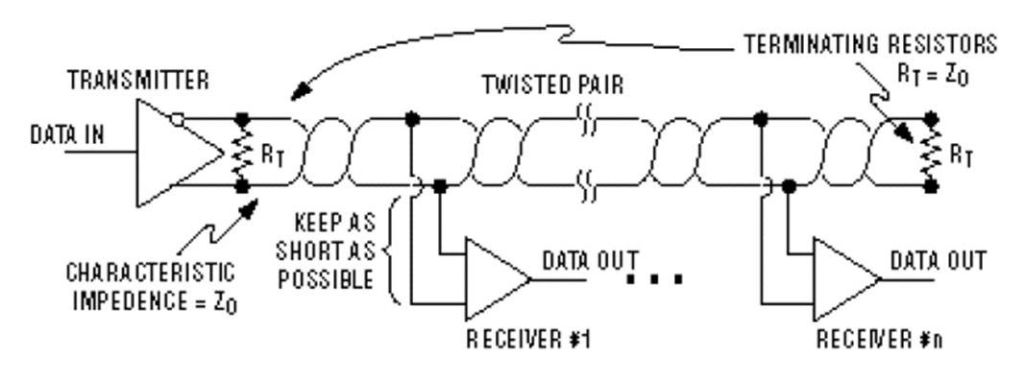
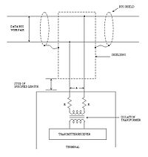
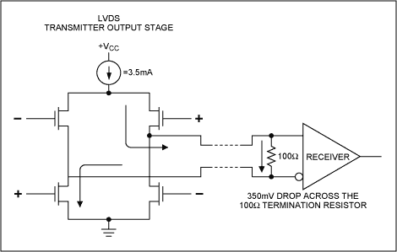
Differential Interface Examples
RS-422
MIL-STD-1553B
Low Voltage Differential Signal
(LVDS)

Slide 34
Demo 6: Current Return Path
DEMO/TUTORIAL: Current Return: The Path of Least IMPEDANCE
  Video and full presentation on NESC Academy website:
    http://nescacademy.nasa.gov/
  Link on GSFC EMC Working Group XSPACES page:
    https://xspaces.gsfc.nasa.gov/display/EMCWG/Tutorials
  Summary on following slides

Slide 35
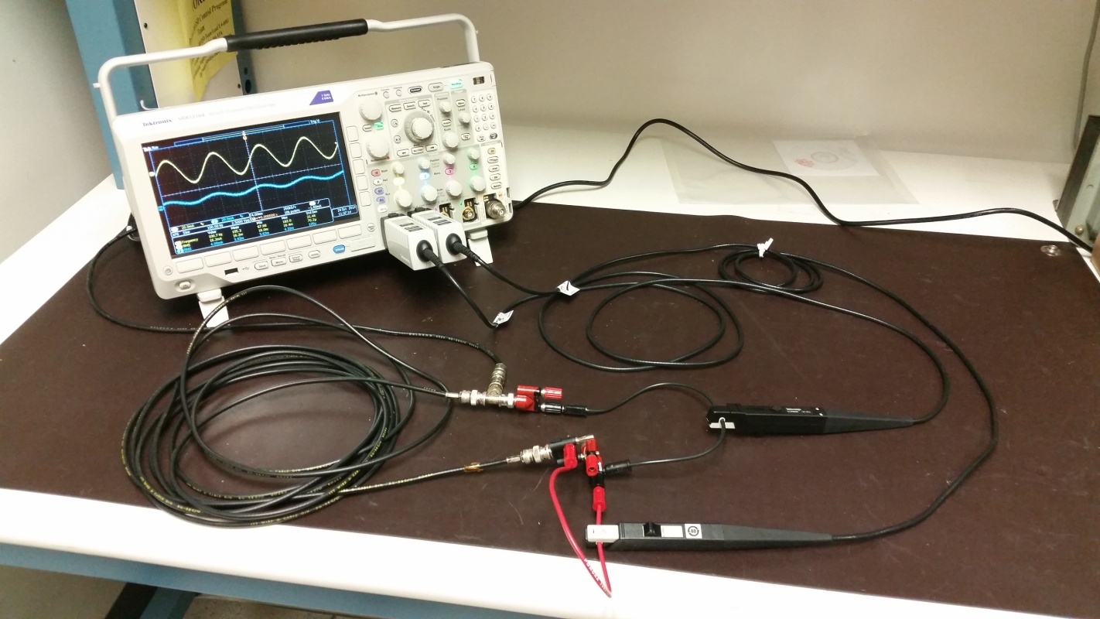
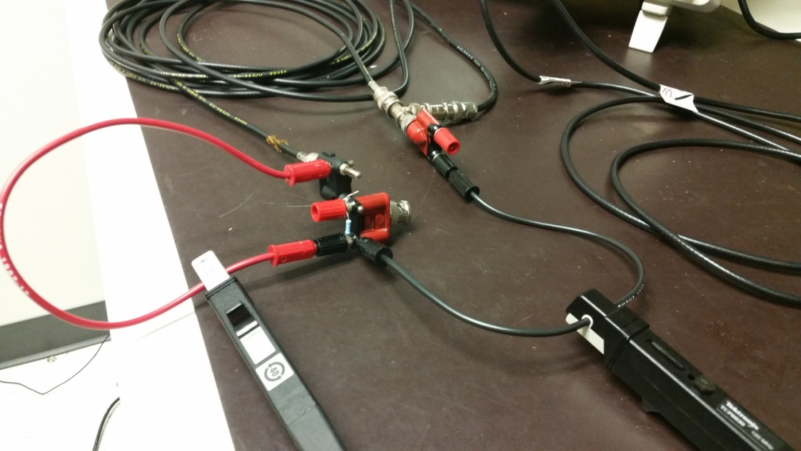
Demo 6: Current Return Path
SHUNT WIRE RETURN CURRENT
SHIELD RETURN CURRENT
CURRENT DIVIDES BETWEEN SHIELD AND SHUNT WIRE

Slide 36
Demo 6: Current Return Path (cont.)
Equipment
  Tektronix MDO3104 oscilloscope (built-in signal generator)
  Tektronix TCP0030 current probes, 2
  RG-58 coax, long (6.2 m)
  RG-58 coax, short (~1 m)
  BNC T-adaptor
  Banana-BNC adaptors, 2 (1 with 50 Ω resistor)
  BNC-banana adaptor, 1
  Short wires with banana leads, 2

Slide 37
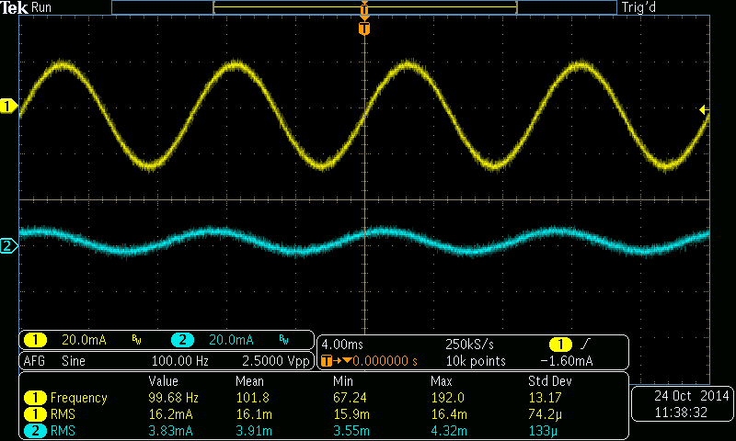
Demo 6: Current Return Path (cont.)
SHIELD CURRENT
SHUNT WIRE CURRENT

Slide 38
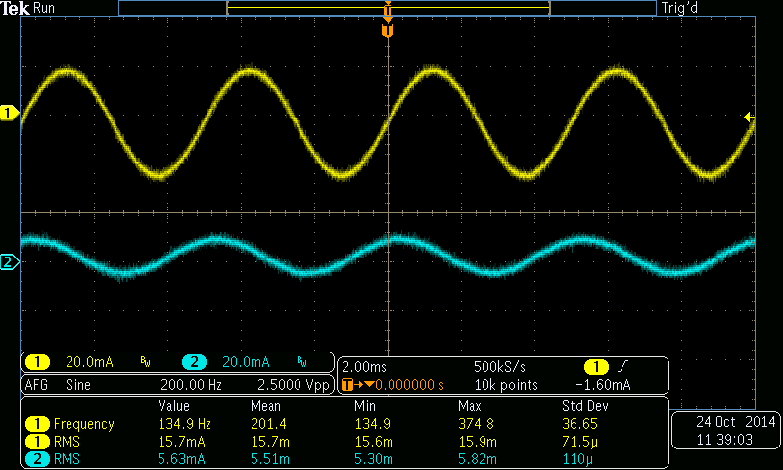
Demo 6: Current Return Path (cont.)

Slide 39
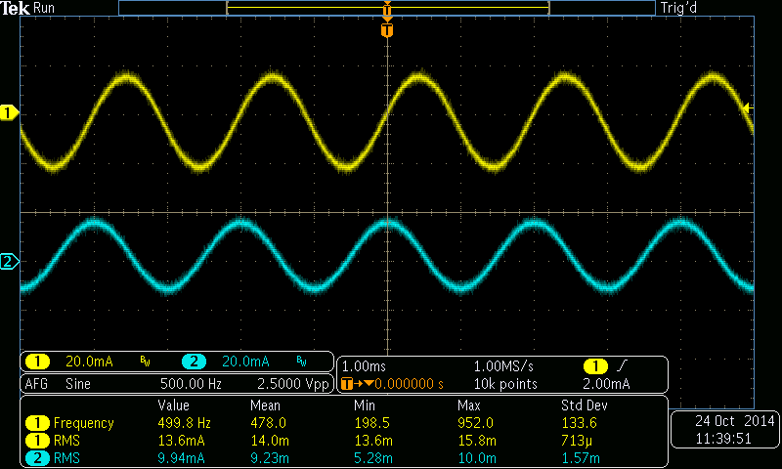
Demo 6: Current Return Path (cont.)

Slide 40
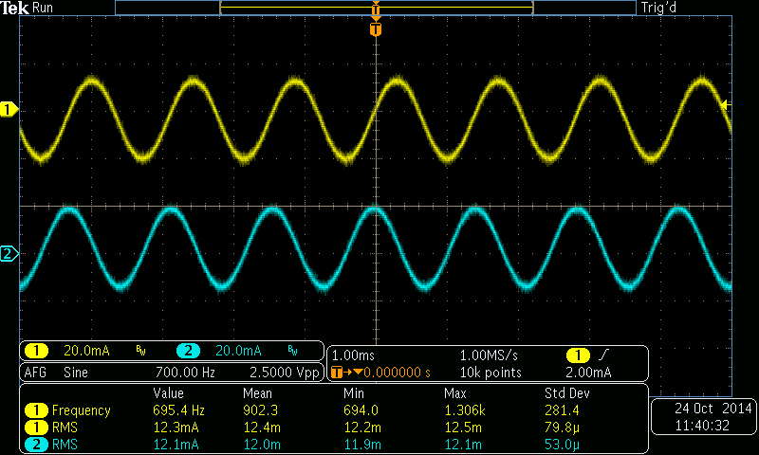
Demo 6: Current Return Path (cont.)

Slide 41
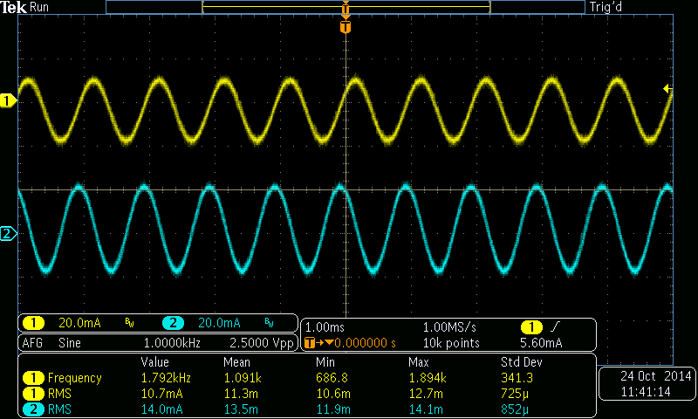
Demo 6: Current Return Path (cont.)

Slide 42
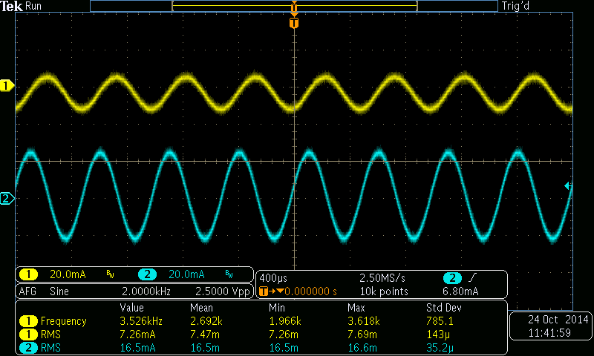
Demo 6: Current Return Path (cont.)

Slide 43
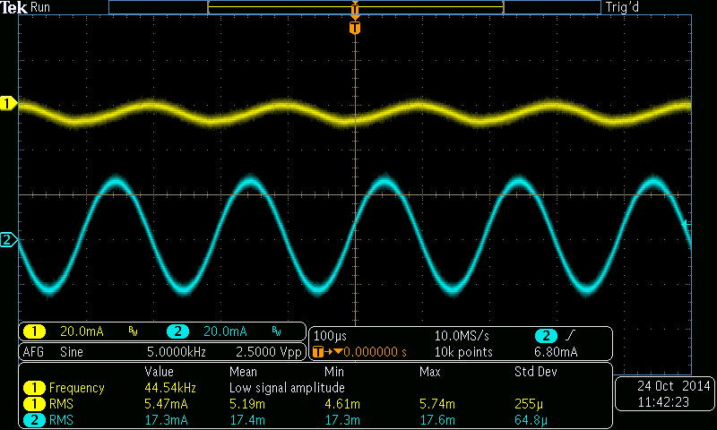
Demo 6: Current Return Path (cont.)

Slide 44
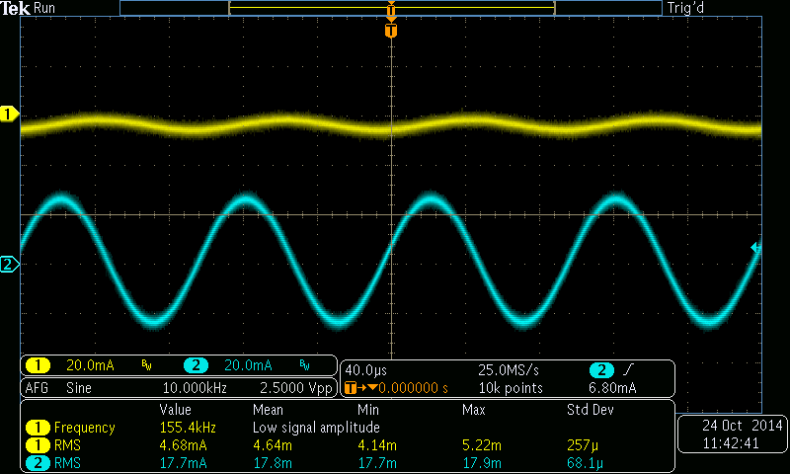
Demo 6: Current Return Path (cont.)

Slide 45
Demo 6: Current Return Path (cont.)

Slide 46
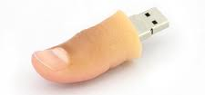
Kirchhoff’s Current Law
All currents return to their sources following path of least IMPEDANCE
  NOT always path of least resistance
Currents do NOT return to ground
  They may use ground as the return path to their source, if that is the path of least impedance
BIG Rule of Thumb for EMC: “Follow the current”

Slide 47
Current Return Path Observations
CIRCUIT 1
CIRCUIT 2
V₀
50 Ω
Illustration of “multi-point” ground at work at “high” frequencies
  Path of least inductance (smallest loop area) is preferred path at “high” frequencies
  Inductance dominates over resistance at “higher” frequencies (> 100 kHz)
  “Ground loops” less of a concern at these frequencies
  Inductance can work to your advantage for controlling return current paths
Practical implications for circuit and system design:
  Provide deliberate low inductance (small loop area) return paths for high frequency currents (let nature do the work)
  Cabling: twisted pairs, coax
  PC board: return (-) trace immediately adjacent to send (+) trace
  If using ground plane as return path, avoid routing traces over splits in ground plane

Slide 48
If You Remember Nothing Else From Today…
DO YOU KNOW WHERE YOUR CURRENTS ARE FLOWING?

Slide 49
Topics
Introduction
Reasons for “Grounding”
“Grounding” in the “Real World” (and in “Real Space”)
Bonding

Slide 50
Bonding
Remember…
  A poor (high impedance) bond will limit fault current
  Hardware can be damaged without blowing fuse (bad)
FUSE MAY NOT CLEAR (BAD)
V_{S}
R_{L}
HIGH IMPEDANCE BOND
FAULT CURRENT RETURN PATH

Slide 51
Bonding (cont.)
Good metal-to-metal contact is essential to minimize ΔV and I_{CM} between surfaces
Non-conductive coatings must be avoided
Must be considered in conjunction with thermal requirements
SHIELD
SIGNAL CONDUCTOR
Minimize ΔV and I_{CM} between box and structure

Slide 52
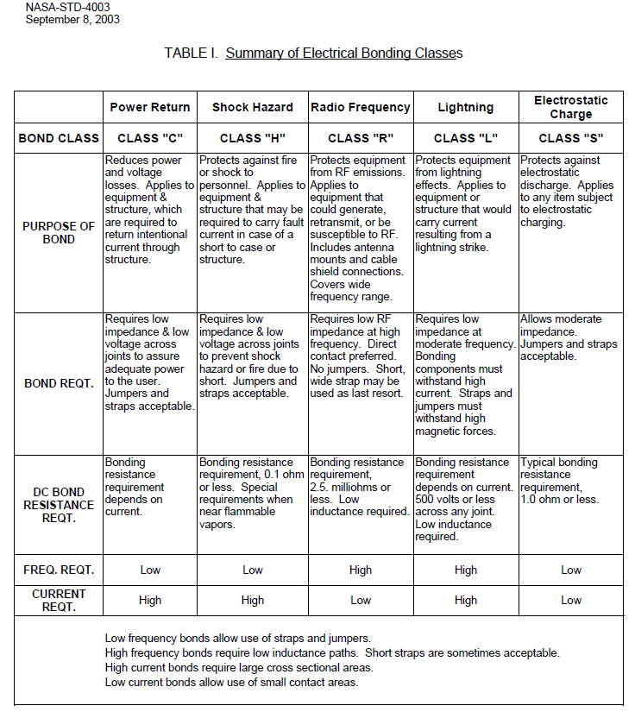
Bonding - NASA-STD-4003

Slide 53
Bonding – Class H (Shock and Fault Protection)
From NASA-STD-4003, Electrical Bonding for NASA Launch Vehicles, Spacecraft, Payloads, and Flight Equipment:
  4.2 Shock and Fault Protection (Class H) – excerpts:
    All electrically conductive equipment cases that may develop potentials due to short circuits shall be electrically bonded to structure.
    Bonding of structural joints in the fault current return path shall provide for the maximum current that may be delivered by the power supply until the fuse or circuit breaker disconnects.
    Exposed cases or chassis of electrical or electronic equipment shall be bonded to structure with a resistance of 0.1 ohm or less.

Slide 54
Bonding – Class R (Radio Frequency)
From NASA-STD-4003, Electrical Bonding for NASA Launch Vehicles, Spacecraft, Payloads, and Flight Equipment:
  4.3 Electromagnetic Interference or Radio Frequency (Class R) – excerpts:
    RF bonding is required between all conductive basic structural components of the vehicle.
    The dc resistance across each joint shall not exceed 2.5 milliohms.
    The dc resistance from equipment case to structure shall not exceed 2.5 milliohms.

Slide 55
Bonding – Class R (cont.)
From NASA-STD-4003, Electrical Bonding for NASA Launch Vehicles, Spacecraft, Payloads, and Flight Equipment:
  6.4 Electromagnetic Interference or Radio Frequency (Class R):
    There is no RF design basis for the historical 2.5-milliohm requirement except to ensure a good metal-to-metal contact that can be expected to be consistent.
    If the use of bond straps for RF bonds is unavoidable, strap length should always be limited to a length to width ratio of 5 to 1.
    The 2.5-milliohm, dc resistance requirement is good for a standard, but one should not assume a good RF bond exists just because the dc resistance is less than 2.5 milliohms. Also, extra effort need not be made just to satisfy the dc requirement if the RF impedance is much higher due to the inductance of the configuration. Look at the whole configuration to get the lowest impedance possible at the frequencies of interest to produce a good RF bond.
GROUND STRAP
(l/w < 5:1)
BOX
GROUND PLANE

Slide 56
Bonding Summary
Class H
  Shock and Fault Protection
  0.1 ohm
  Must have current capacity to withstand worst-case fault current
Class R
  Radio Frequency (RF)
  2.5 milliohms
  Direct metal-to-metal contact preferred
  If a strap is used, use minimum length-to-width ratio of 5:1
    Much less inductance than wire
    Multiple straps recommended (one on each face of box)

Slide 57
If You Remember Nothing Else From Today…
DO YOU KNOW WHERE YOUR CURRENTS ARE FLOWING?

